Slide 1
E-IDC Training: Managing Financial Transactions Effectively
Date: November 19,2025
Prepared by: Nahid Talebi, Business & Finance

Slide 2
E-IDC ( Interdepartmental Charges)
An E-IDC is used to:
Correct financial transactions charged to an incorrect chart string or department
Transfer expenses between departments or programs
Allocate costs appropriately across budget lines
Ensure accurate financial reporting and compliance with budget policies

Slide 3
When to Submit an E-IDC
You should submit an E-IDC when:
Payroll or other expenses have been incorrectly charged
A budget manager requests a transfer of funds
Shared costs (e.g., supplies, food, services) need to be distributed across multiple departments
You are reconciling monthly or quarterly budget reports and find discrepancies

Slide 4
Why and when we need to do an IDC
As the Budget Manager, we need to monitor our budget and make necessary adjustments as needed, including:
Correcting payroll expenses when an employee’s payroll is charged to the wrong budget chart string (Fund, Appr Index, Dept. Class, etc.).
Distributing expenses between two or more departmental budgets.
Correcting expense account charges.

Slide 5
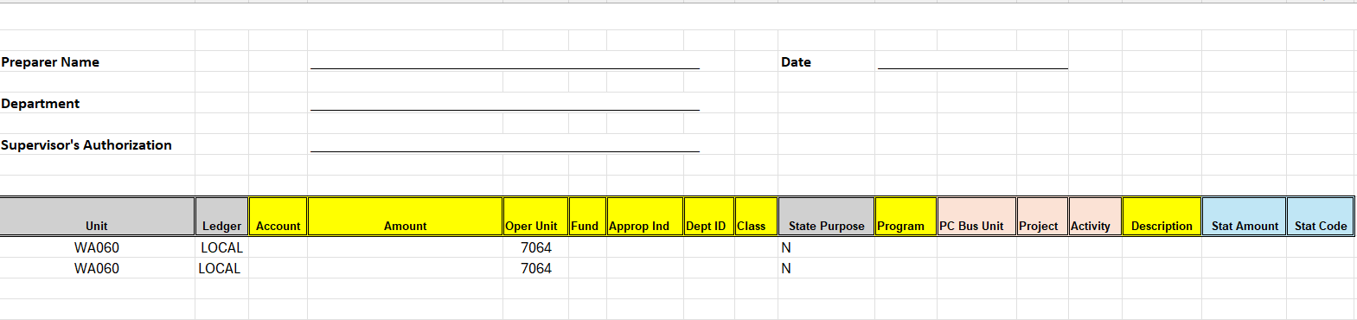
How to do an IDC
Please use the E-IDC form and complete all required fields highlighted in yellow.
When naming the E-IDC, follow this format:
[E-IDC-SBONT001]
Campus Initial: S
Department Initial: BO
Your Name Initial: NT
Number: 001

Slide 6
Back up submission
Please provide backup documentation, such as:
  Payroll report
  Expense report
  Email from the Budget Manager requesting the IDC
Other examples of acceptable backup documentation include:
  Food form
  Agenda
  Sign-up sheet
  Receipts

Slide 7
Queries to Use for Your Budget Check
QFS_CO_HR_ACCT_LINE_PAY_PERIOD – Use this query to review payroll charges by pay period.
QFS_KK_BUDGET_OVERVIEW_OPR_DTL – Use this query to get a detailed operational overview of your budget.
After your IDC has been approved by the Department Manager,
please submit it through the Ticketing System to the South
Business Office

Slide 8
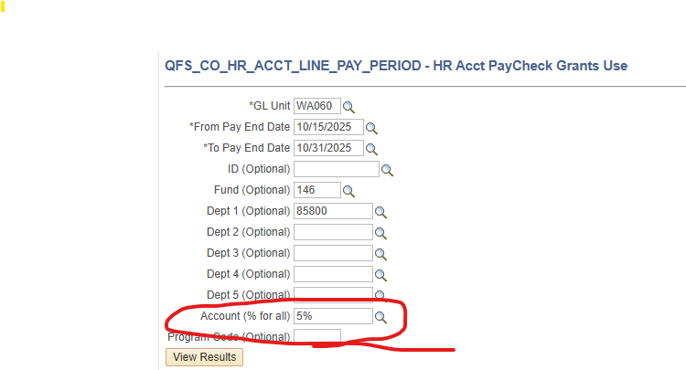
How to run query:
For Payroll :

Slide 9
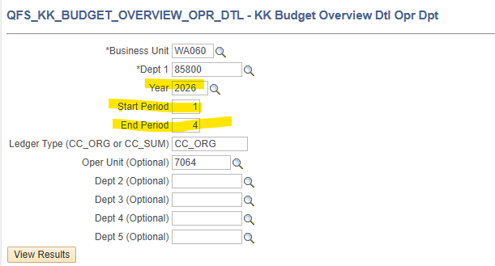
How to run query:
For Budget Overview or Expenses :

Slide 10
How to Locate the E-IDC:
All materials, including the new E-IDC and instructions, can be found on our website.
E-IDC Training

Slide 11
QUESTIONS?

