Slide 1


Slide 2
VOICES Mission Statement
VOICES is a collaborative community furthering South Seattle Community College’s commitment to providing lifelong learning opportunities with respect to ensuring inclusion, equity and social justice. VOICES promotes a vision of cultural sensitivity, fostering a climate of awareness of and appreciation for diversity (2010).

Slide 3
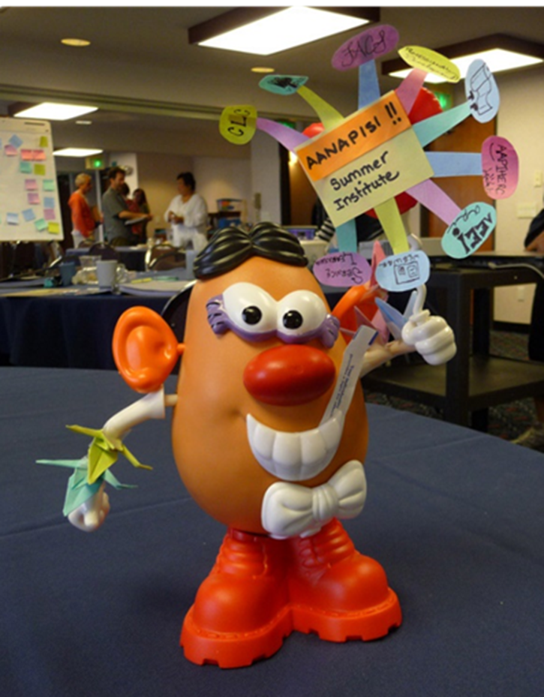
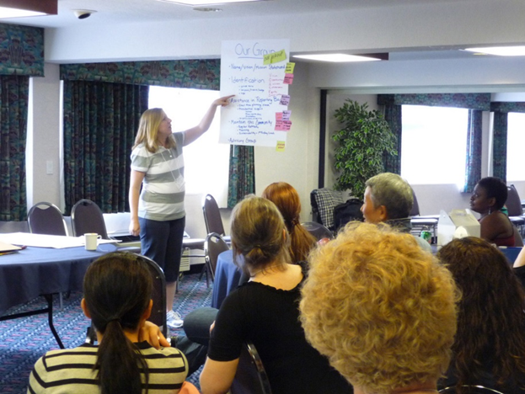
VOICES I: Ocean Shores 2010

Slide 4
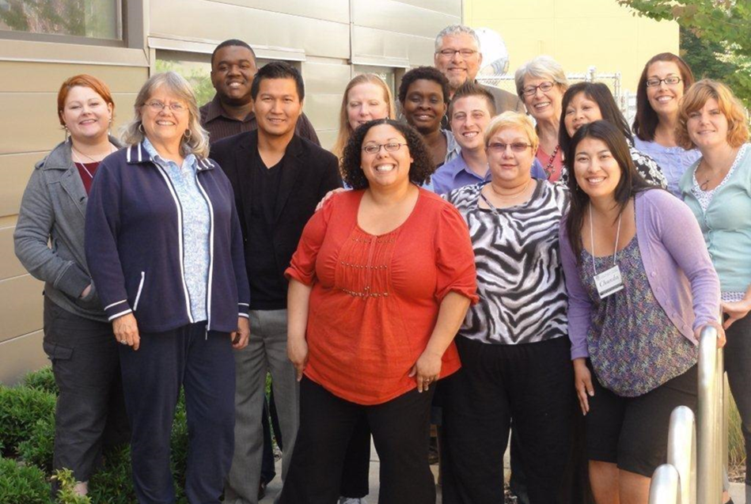
VOICES II: Georgetown Campus 2012

Slide 5
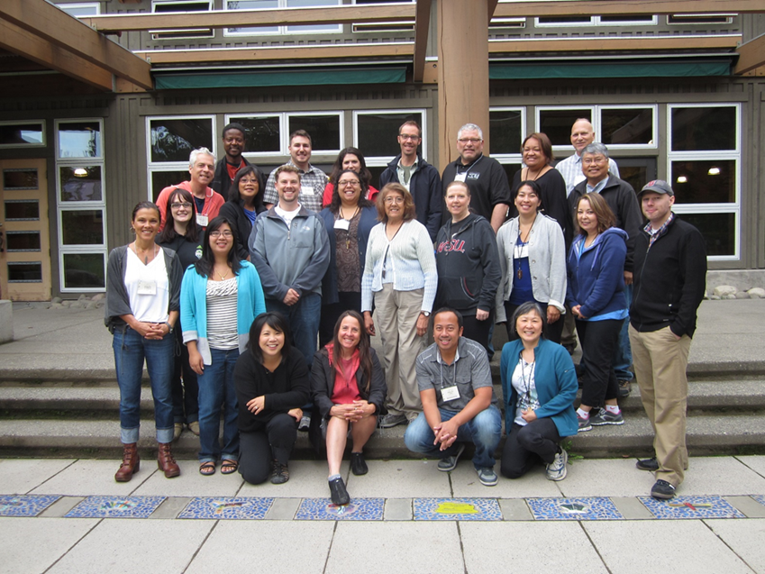
VOICES III: Islandwood 2013

Slide 6
VOICES Participants 2011 - 2014
Alex Abeyta
Jennifer Cepak
Dorrienne Chinn
Renata Cummings
Tram Dang
Kelly DeForrest
Bob Dela-Cruz
Sy Ear
Teri Eguchi
Katie Frazier
Erik Gimness
Elaine Gottschalk
Joshua Hancock
Chad Hickox
Chanda Ishisaka
Lolita Khachaturova
Ana Korsmo
Kathie Kwilinski
Astrid Larsen
Ricardo Leyva-Puebla
May Lukens
Kori Lumpkin
Monica Lundberg
Kris Lysaker
Chase Magliocca
Jill McDonough
Jon Nachman
Sharon Norman
Dana Owens
Terry Paull
Nancy Peregrine
Kathy Reistad
Barry Robinson
Carey Schroyer
Natalie Simmons
Dedrick Smith
Mary Sitterley
Allen Stowers
Roxanne Tillman
Alisa Torres
Debbie Park-White
Kathy Whitham
Karen Whitney
Christie Williams
Annie Zadra

Slide 7
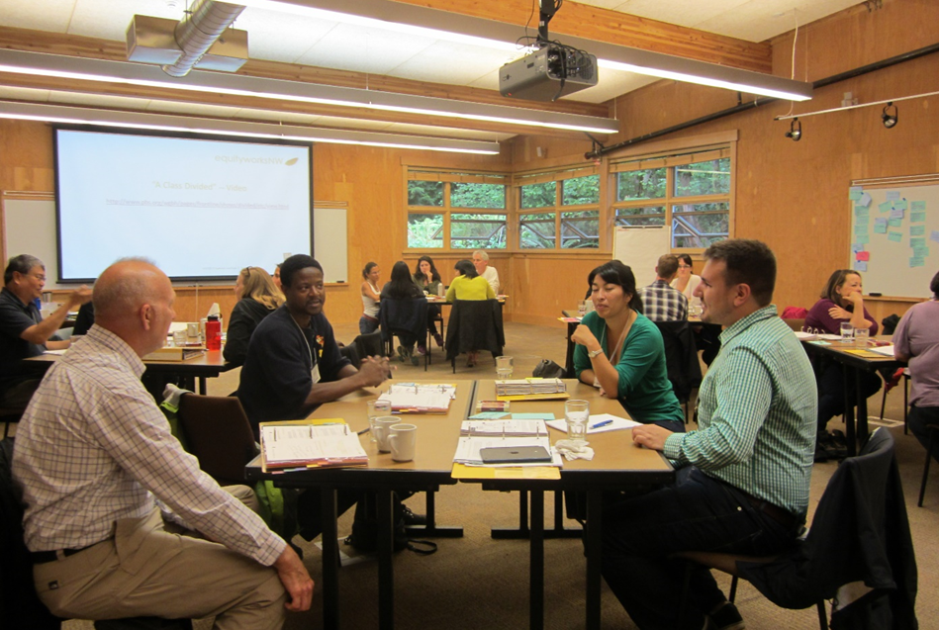
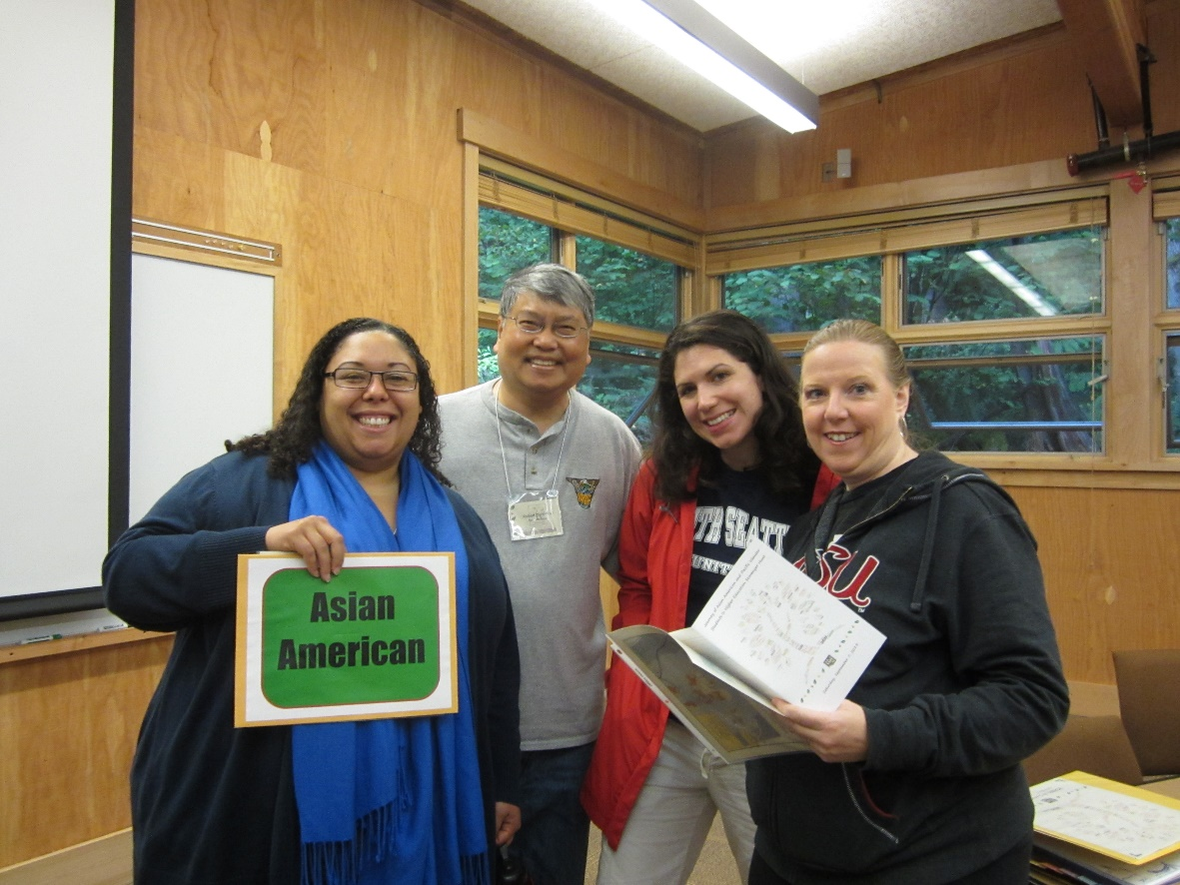
VOICES III: Summer Institute 2013

Slide 8
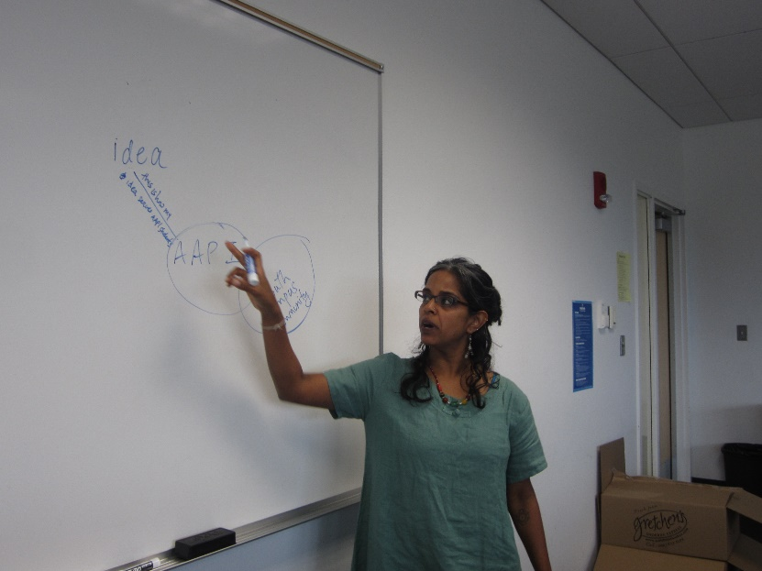
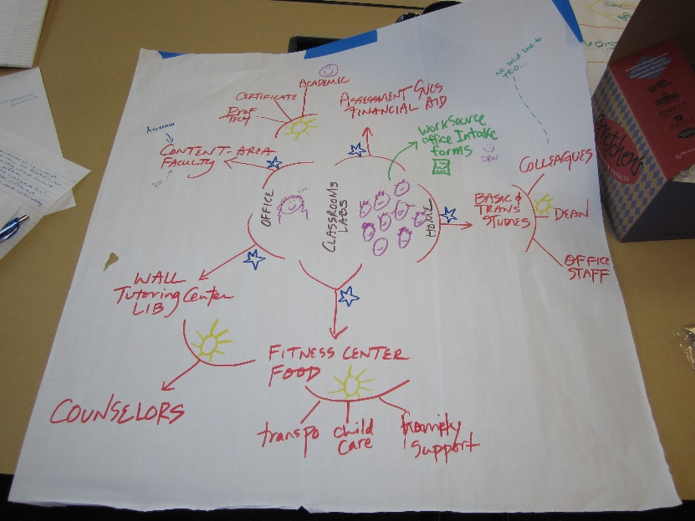
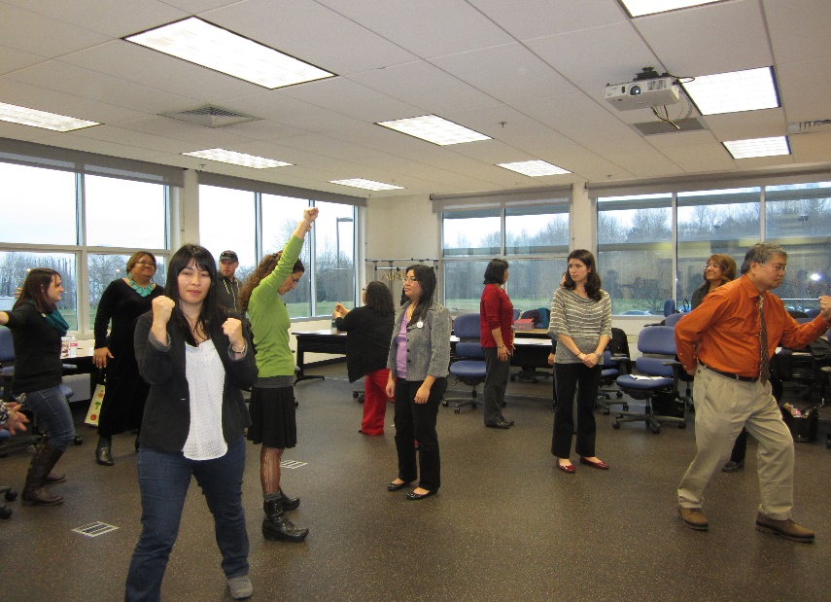
Transformative Curriculum Workshops
Brainstorming
Mapping the Institution
Exploring AAPIs in Higher Education
Difficult Dialogues I & II

Slide 9
“Stories of South”
TRiO
AANAPISI
Title III
The New Student Services
Public Information Office
Videos:
Student Tips
Jack Kent Cooke Scholar "reveal" video

Slide 10



“Integrating AAPI Culture through Conceptualized Reading”
Fall Quarter 2013
Winter Quarter 2014
Spring Quarter 2014

Slide 11
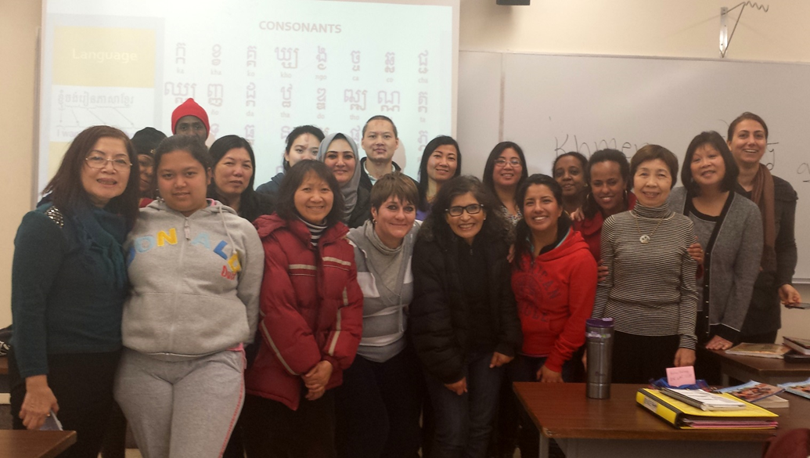
ESL Class Winter 2014

Slide 12


“College Awareness for AAPI Students Designated
Under HB 1079”

Slide 13
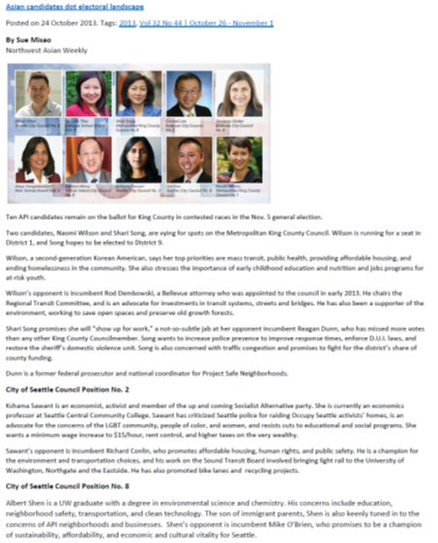

Slide 14
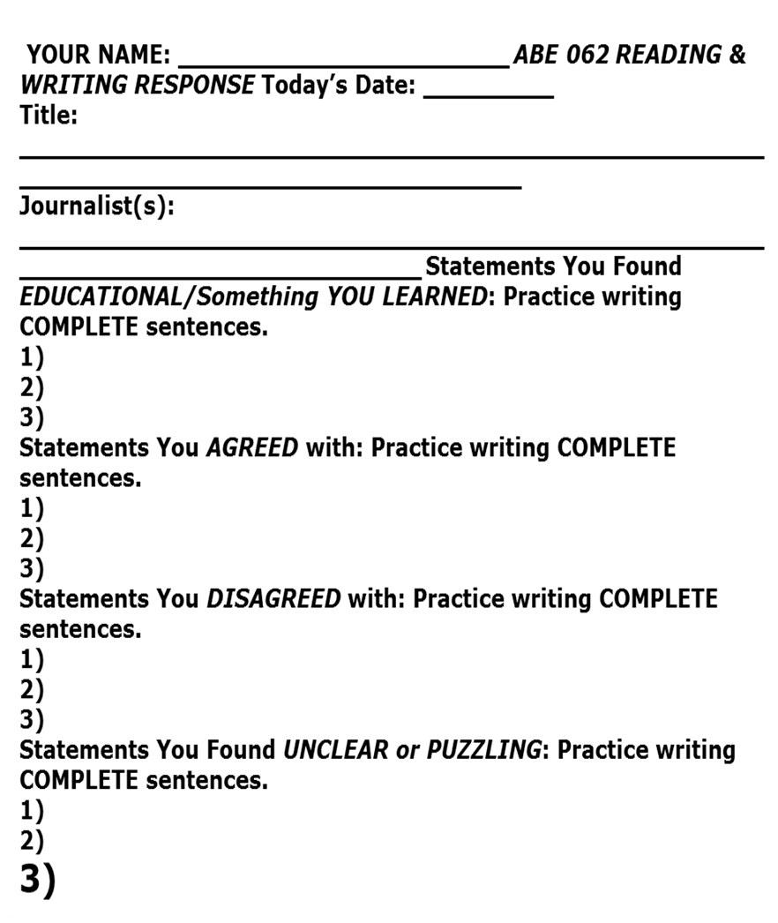
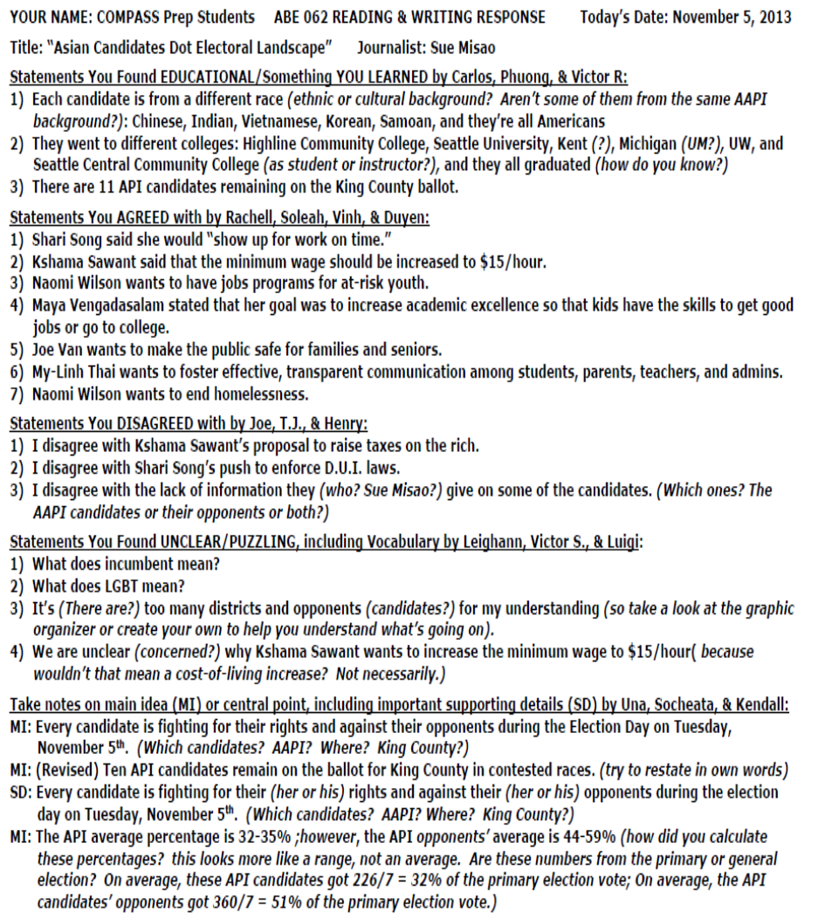
AAPI General Election Assignment

Slide 15
ABE Advising through Persistent Intervention (AAPI) for COMPASS Class

Slide 16



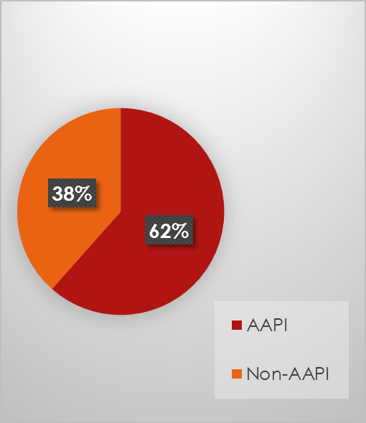
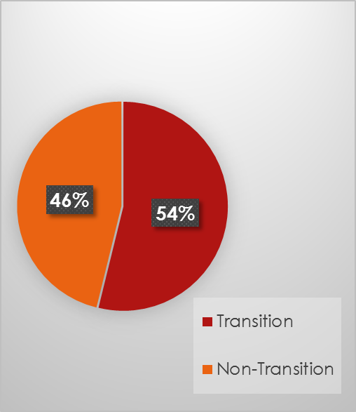
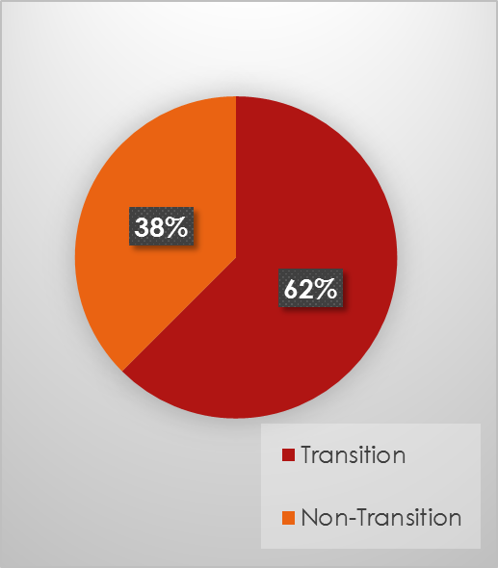
Fall 2013 COMPASS Class Outcomes

Slide 17
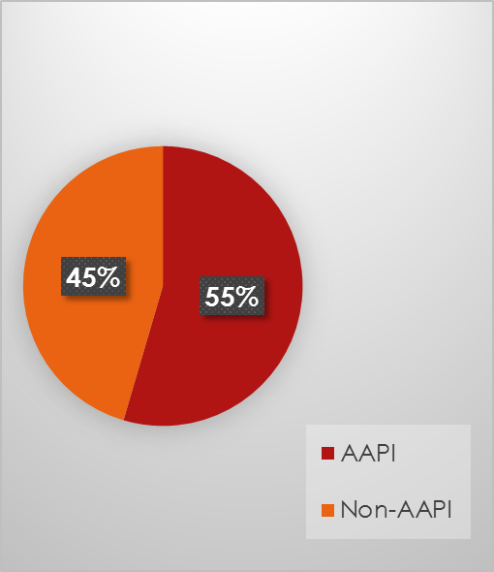
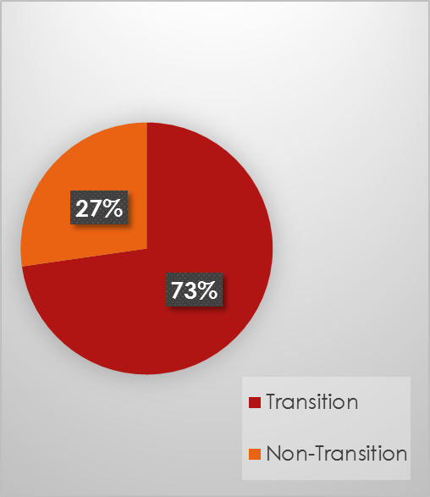
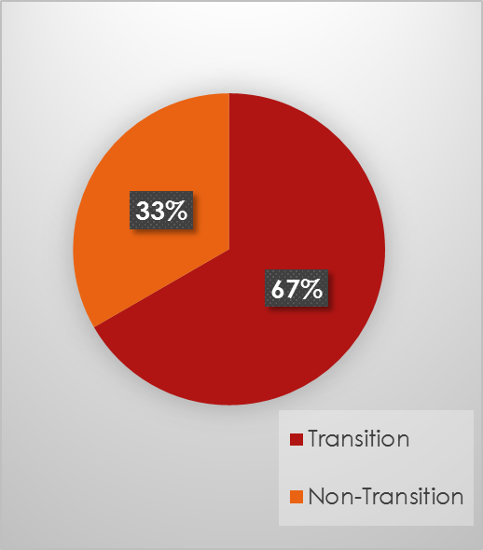
Winter 2014 COMPASS Class Outcomes

Slide 18
Promising Results from Fall 2013
VOICES INTERVENTION OUTCOMES

Slide 19
Five Dimensions of Engagement
Cognitive Engagement
Behavioral Engagement
Teacher Press
Student-Faculty Interactions
Academic Resilience

Slide 20
Types of Tests
VOICES vs. non-VOICES
AAPI vs. non-AAPI
Repeated Measures (pre- vs. post-tests)
AAPI vs. non-AAPI (VOICES)

Slide 21
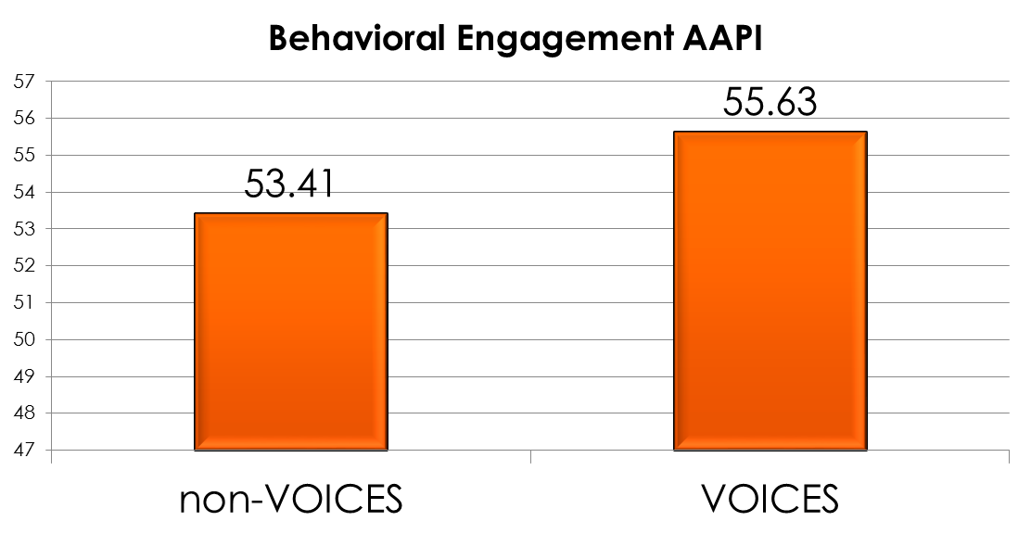
Behavioral Engagement VOICES vs. non-VOICES

Slide 22
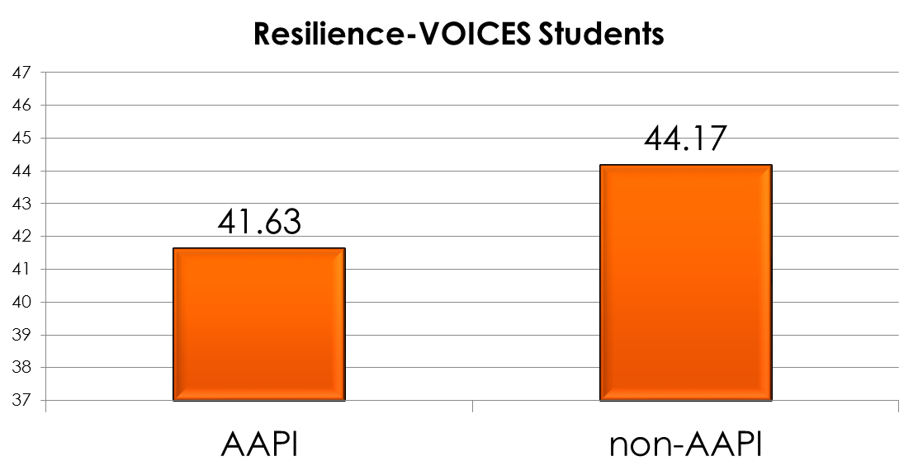
Academic Resilience AAPI vs. non-AAPI

Slide 23
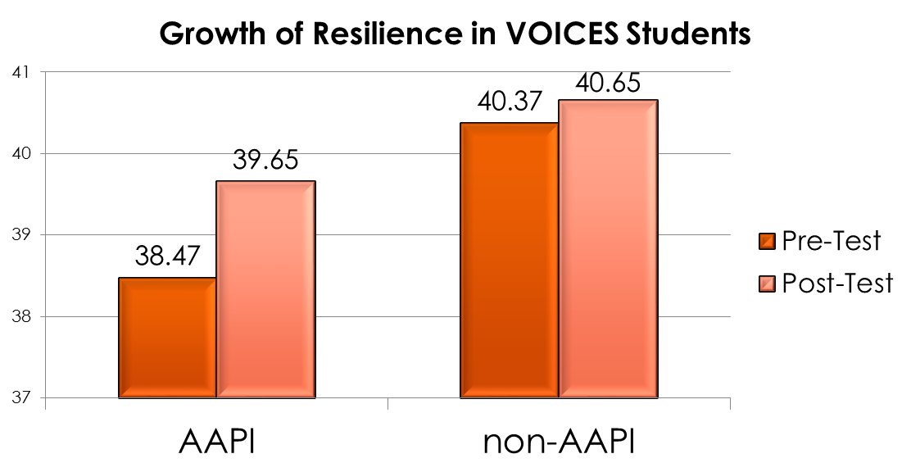
Academic Resilience Repeated Measures

Slide 24
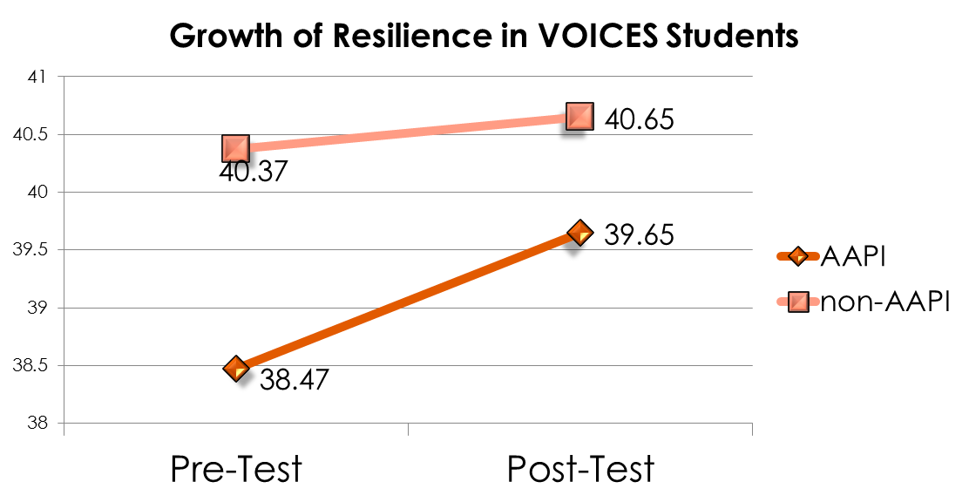
Academic Resilience Repeated Measures

Slide 25


THANK YOU!
Partnership for Equity in Education through Research
(National PEER organization) for funding VOICES III
and next year’s Best Practices Showcase along with
South’s AANAPISI grant (funding).
Our campus PEER Evidence Team for supporting
VOICES III as our 2013-2014 project.
South’s IDI Qualified Administrative Team for
administering the IDI.
Our Summer Institute subject matter experts –Dr. Anu Taranath, Rochelle Fonoti, Ammara Kimso, Ricardo Leyva-Puebla, Nani Jackins Parks, Dr. Nikum Pon, Maureen Shadair, May Lukens.
Dr. Anu Taranath, Rochelle, and Ammara for leading us through this journey of transformative curriculum
and Pedagogy.
Kori Lumpkin for helping us coordinate the pieces
To our VOICES III participants for whom this would
not be possible without.

